Slide 1
Logistic Regression
Introduction and Applications

Slide 2
Introduction
What is it?
A Logistic Regression Model is:
1. A type of Generalized Linear Model (GLM) that relaxes some of the assumptions of Linear Regression such as Normality of Residuals and Constant Variance and also assumes the output follows a Bernoulli Distribution (think coin tosses, heads or tails only) as a function of the model parameters used to model binary responses
2. A model that measures the relationship between a categorical (discrete) dependent variable and one or more independent variables which can be either continuous or categorical
3. A type of Linear Classifier that can predict the probability of two (or more) discrete categories from input, (age, weight, blood pressure, cholesterol level -> coronary heart disease or healthy) as well as odds of the category occurring

Slide 3
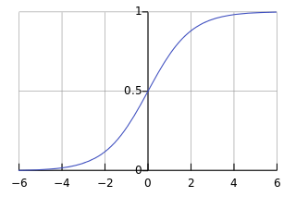
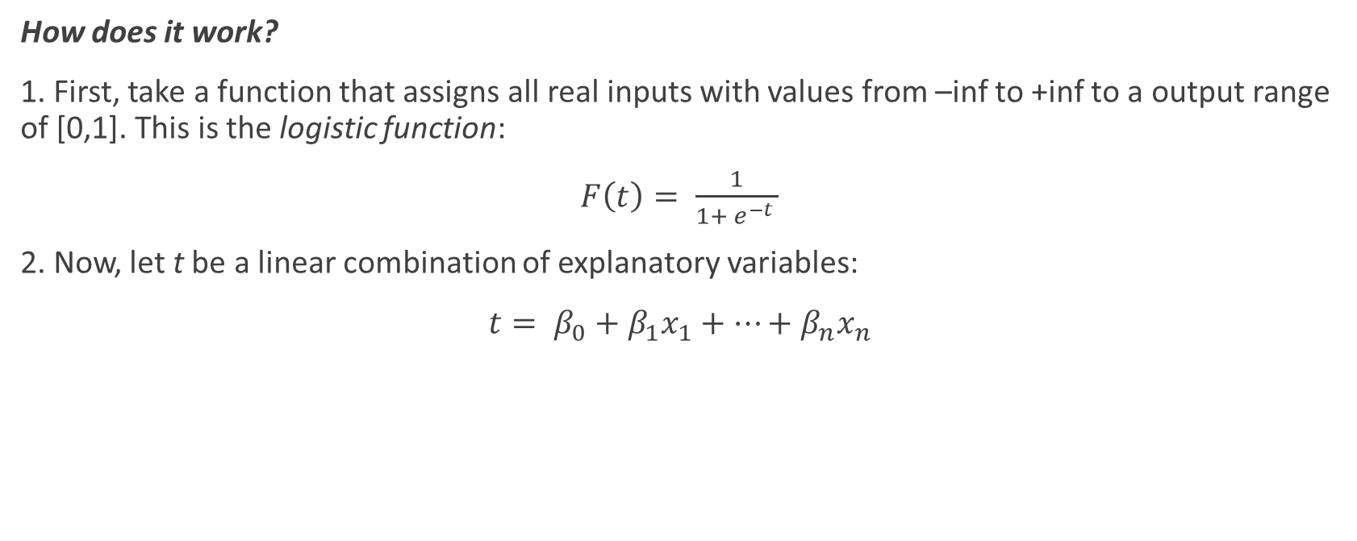
Introduction
How does it work?
1. First, take a function that assigns all real inputs with values from –inf to +inf to a output range of [0,1]. This is the logistic function:
$F\left(t\right)= \frac{1}{1+ e^{−t} }$
2. Now, let t be a linear combination of explanatory variables:
$t= β_{0}+β_{1}x_{1}+…+β_{n}x_{n}$

Slide 4
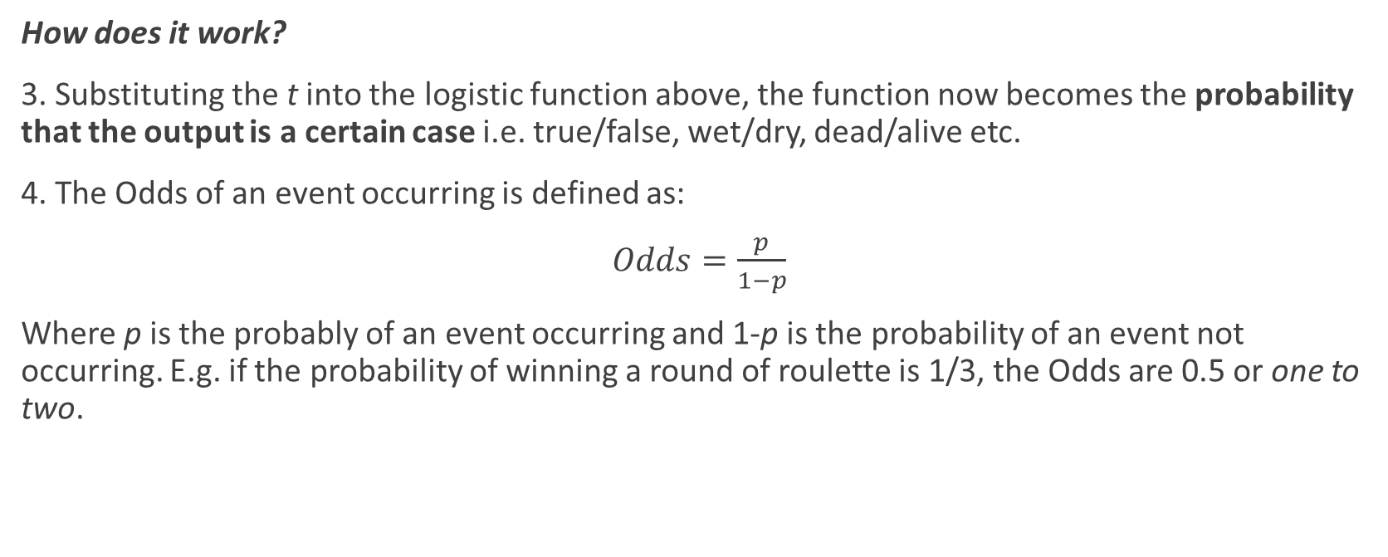
Introduction
How does it work?
3. Substituting the t into the logistic function above, the function now becomes the probability that the output is a certain case i.e. true/false, wet/dry, dead/alive etc.
4. The Odds of an event occurring is defined as:
$Odds=\frac{p}{1−p}$
Where p is the probably of an event occurring and 1-p is the probability of an event not occurring. E.g. if the probability of winning a round of roulette is 1/3, the Odds are 0.5 or one to two.

Slide 5
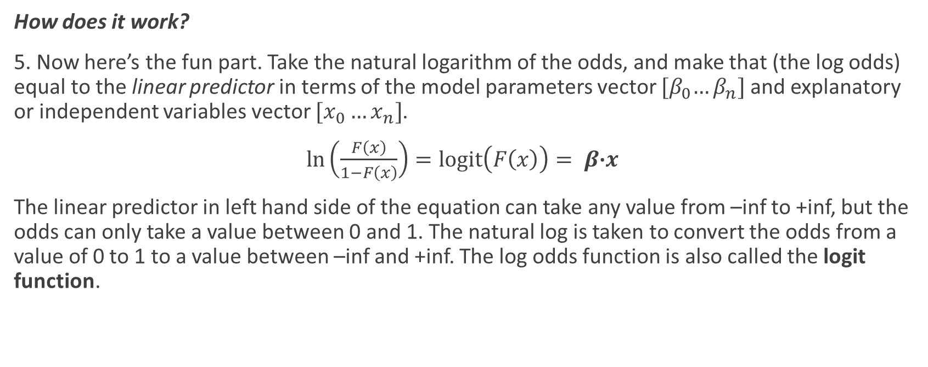
Introduction
How does it work?
5. Now here’s the fun part. Take the natural logarithm of the odds, and make that (the log odds) equal to the linear predictor in terms of the model parameters vector ${[β}_{0}…β_{n}]$and explanatory or independent variables vector $[x_{0}…x_{n}]$.
$\ln\left(\frac{F\left(x\right)}{1−F\left(x\right)}\right)=logit\left(F\left(x\right)\right)= β\text{·}x$
The linear predictor in left hand side of the equation can take any value from –inf to +inf, but the odds can only take a value between 0 and 1. The natural log is taken to convert the odds from a value of 0 to 1 to a value between –inf and +inf. The log odds function is also called the logit function.

Slide 6
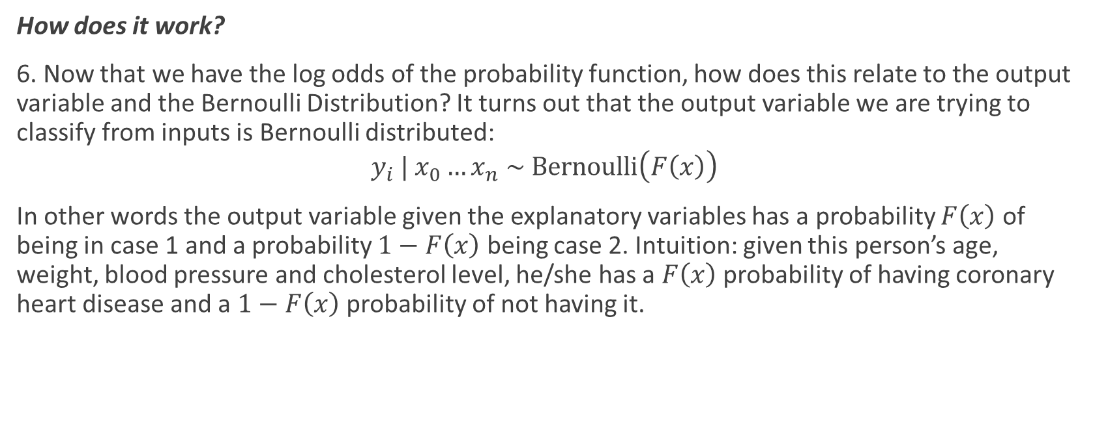
Introduction
How does it work?
6. Now that we have the log odds of the probability function, how does this relate to the output variable and the Bernoulli Distribution? It turns out that the output variable we are trying to classify from inputs is Bernoulli distributed:
$$y_{i} | x_{0}…x_{n} \sim Bernoulli\left(F\left(x\right)\right)$$
In other words the output variable given the explanatory variables has a probability $F\left(x\right)$ of being in case 1 and a probability $1−F\left(x\right)$ being case 2. Intuition: given this person’s age, weight, blood pressure and cholesterol level, he/she has a $F\left(x\right)$ probability of having coronary heart disease and a $1−F\left(x\right)$ probability of not having it.

Slide 7
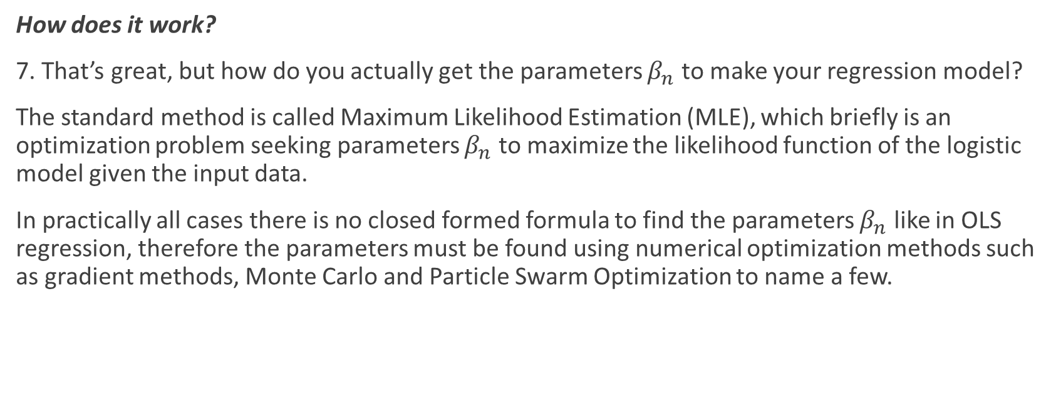
Introduction
How does it work?
7. That’s great, but how do you actually get the parameters $β_{n}$ to make your regression model?
The standard method is called Maximum Likelihood Estimation (MLE), which briefly is an optimization problem seeking parameters $β_{n}$ to maximize the likelihood function of the logistic model given the input data.
In practically all cases there is no closed formed formula to find the parameters $β_{n}$ like in OLS regression, therefore the parameters must be found using numerical optimization methods such as gradient methods, Monte Carlo and Particle Swarm Optimization to name a few.

Slide 8
Application Example
What can I do with it?
1. Application example: we will explore a 2 input explanatory variable to one categorical output model in a Biomedical or Physiology setting. This particular logistic regression model will attempt to determine the effect of Inhaled Air Volume (Volume) and Air Inhalation Rate (Rate) on the probability of Vasoconstriction (Y) or constriction of small arteries in the fingers of test subject from a provided dataset.
Go ahead and read the dataset into R:
> vdata <- read.table("vaso.txt", header = T)
Useful functions to try:
> summary(vdata)
> sapply(vdata,sd)

Slide 9
Application Example
What can I do with it?
2. Now we are ready to do the regression. R takes care of the parameter fitting for you.
> vlogreg <- glm(Y ~ Volume + Rate, data = vdata, family = ‘binomial’)
Now call summary() on vlogreg to obtain your fitted parameters as well as their significance levels.
Question: How many parameters are significant?
3. Now comes the fun part, extracting information from the regression model and doing interpolation. The extract the odds ratios and 95% C.I. from the model:
> exp(cbind(OR = coef(vlogreg ), confint(vlogreg)))
The interpretation is that 1 unit increase in an explanatory variables increases the odds of the response variable occurring vs not occuring by the OR factor.

Slide 10
Application Example
What can I do with it?
4. Since we have a complete regression mode, we can interpolate explanatory variable to give a probability of the response category. Create a new data frame with some reasonable explanatory variable values:
> vnewdata <- with(vdata, data.frame(Volume = runif(4,min=0.5,max=4), Rate = runif(4,min=0.5,max=3)))
We can create a new column in the dataframe where our Vasoconstriction probability can go:
> vnewdata$vp <- predict(vlogreg, newdata=vnewdata, type = “response”)
What probabilities do you get?

Slide 11
Application Example
What can I do with it?
5. Plotting and visualization. For this task we will create a range of explanatory variables and explore how they affect the response probability. First, create a large explanatory dataset:
> vnewdata2 <- with(vdata, data.frame(Volume = runif(100,min=0.1,max=4), Rate = runif(100,min=0.1,max=4)))
Next create the prediction dataframe:
> vnewdata3 <- cbind(vnewdata2, predict(vlogreg, newdata = vnewdata2, type = "link", se=TRUE))
WIP Add 3d plots

Slide 12
Refrences
1. http://www.ats.ucla.edu/stat/r/dae/logit.htm

